Slide 1
Welcome to the Cambridge Schools Conference

Slide 2
Using Classroom Discussion to Promote Positive Behaviour
Moving towards a dialogic classroom to promote constructive talk and engagement
Victoria Renfro Head of Professional Development
Roxanna Everson Professional Development Manager
September 2022

Slide 3
Who are we?
18 years in Teaching and Teacher Professional Development
Taught in 5 schools in 4 countries
Former Cambridge Examiner and Trainer
17 years in Teaching, Teacher Training, School Management & Professional Development
International contexts including China, Jordan, Slovakia & Palestinian Territories
Experienced in ESL, post-16 training and SEN teaching in Secondary Education
Victoria Renfro
Head of Professional Development
Roxanna Everson
Professional Development Manager
Notes:
RE – Picture prompts and questions on a handout on each table. Do these pictures remind you of any stories? Can you summarise a story for the people in your group? Did you listen or tell stories when you were a child? What was your favourite? etc
Interaction
Ss-Ss
Ss-F
Sharing with pair – pair member to share with group. Active listening.
Feedback about the other element of dialogue which is listening. How easy was it to listen or were you thinking about what to say? Could you describe your partner's story well? What tools did you need to do that effectively?
5 mins including feedback

Slide 4
Let's Get Started...
On the tables there are some images. Do these images remind you of any stories?
Look at the question prompts and discuss on your tables
Share a story with the group
Notes:
RE – Picture prompts and questions on a handout on each table. Do these pictures remind you of any stories? Can you summarise a story for the people in your group? Did you listen or tell stories when you were a child? What was your favourite? etc
Interaction
Ss-Ss
Ss-F
Sharing with pair – pair member to share with group. Active listening.
Feedback about the other element of dialogue which is listening. How easy was it to listen or were you thinking about what to say? Could you describe your partner's story well? What tools did you need to do that effectively?
Active Listening
5 mins including feedback

Slide 5
Our Session Today
What is dialogue? What is discussion?
Why is classroom dialogue important?
Activities to promote dialogue
Managing expectations
Q&A

Slide 6
Ground Rules for Talk

Slide 7
Ground Rules for Talk
What Ground Rules for Talk do you think that we should have in this session?
Why is it important to have ground rules for classroom talk?
It’s important that ground rule and developed with your class in language that is familiar to them

Slide 8
Ground Rules for Talk
Everyone is encouraged to contribute
Everyone listens actively
People ask questions
People share relevant information
Ideas and opinions are treated with respect
There is an atmosphere of trust
There is a sense of shared purpose
Contributions build on what has gone before
People give reasons for their thinking
Ideas may be challenged
The group seeks agreement for joint decisions

Slide 9
Principles of Dialogic Talk

Slide 10
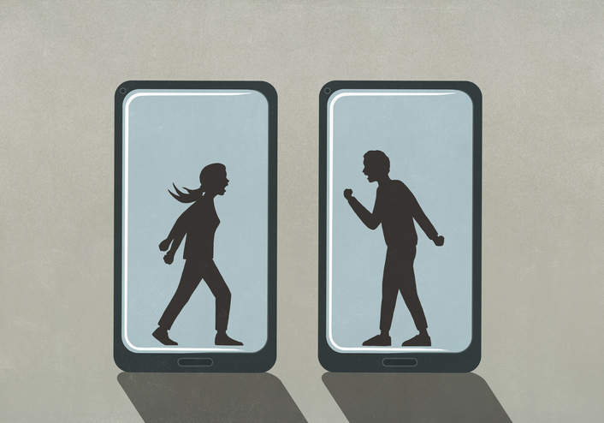
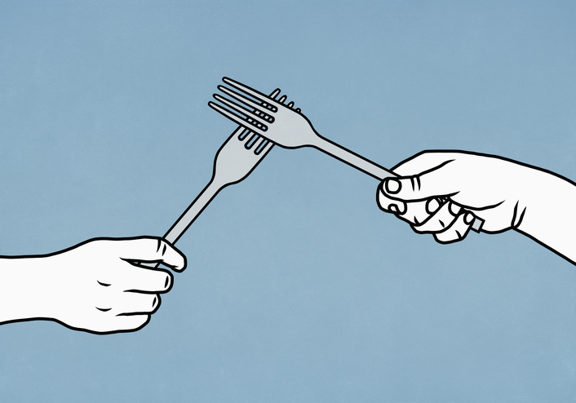
What are the benefits of using dialogue in the classroom?

Slide 11
What are the benefits of using dialogue in the classroom?

Slide 12
Dialogue
Children, we now know, need to talk, and to experience a rich diet of spoken language, in order to think and learn.
Alexander, 2004
…language provides us with a means
for thinking together, for jointly creating
knowledge and understanding.
Mercer, 2000

Slide 13
Discussion and Dialogue
‘The intention of learning how to be ‘dialogic’ in classrooms, usually when working in pairs or small groups, is that learners become tolerant of the differing perspectives of others, able to probe their views sensitively, and able to express and justify their own ideas clearly; the ultimate purpose is that people should be able to genuinely co-construct knowledge with others, an ability that employers say is desperately needed in the C21st. workplace.’
- Paul Warwick, University of Cambridge
Notes:
Discussion are there to lead to decisions – people look to restate and defend their points, convince other of their point of view
When
Dialogue is not about being right, it’s not about convincing other people to follow your ideas, iy’s not about asserting your ideas – it’s about sharing your ideas, litening to other share theirs, being willing to engage with the ideas of other, being able to construct knowledge with others and learn from that co-contruction of knowledge
We not looking to persuade others – we invite others to engage with our ideas, to consider them

Slide 14
What are the benefits of using dialogue in the classroom?
Dialogue is not some simplistic assertion of one’s own position, nor is it necessarily about persuading others to one’s point of view. Dialogue is about demonstrating respect for another’s life, and being determined to learn when confronted with differences in personality and perspective.
Daisaku Ikeda - philosopher, educator, author
Notes:
We not looking to persuade others – we invite others to engage with our ideas, to consider them
Eekada

Slide 15
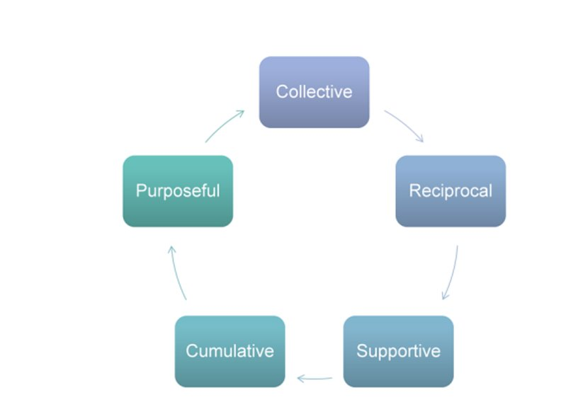
Principals of Dialogic Talk
Notes:
Active Listening
Underpins all of this, you can not take part in dialogue effectively if you are not listening
Discussion is part of a dialogic classroom but dialogue goes further than discussion, being comfortable with discussion is the first sept to greater dialogue in the classroom - not just teacher to student but also learners in groups
The first step to all of this is to guide your learners to listen actively
They have to be asked to do something active with what they have heard – ask a question, repeat, consolidate other peoples ideas, link other peoples ideas
Everyone has had an experience of discussion gone wrong
Share the reasons why discussion goes wrong
In contrast to the IRF approach, a dialogic approach to teaching was developed by Alexander (2004, 2017) and Mercer (2000). It involves the teacher orchestrating classroom discussions to ensure that all learners are engaged and that knowledge is jointly constructed, by encouraging students to build on their own and each others’ contributions, contrasting different students’ ideas and prompting students to evaluate each others’ ideas instead of the teacher being the one to give feedback immediately (Mercer, Hennessy and Warwick, 2017; Resnick et al., 2018; Berry, 2006; Chin, 2006, quoted by Cook et al., 2018) As well as whole-class discussions led by a teacher, learners also take part in Exploratory Talk (Mercer, 2000) where they have discussions in small groups without a teacher, building on, explaining, discussing and justifying their ideas and inviting each other to do the same. A dialogic approach has been found to have a strong impact on students’ learning (Howe et al. 2019; Alexander, 2018)

Slide 16
What are the benefits of using dialogue in the classroom?
Children in Dialogic Teaching schools made two additional months’ progress in English and science, and one additional month’s progress in maths, compared to children in control schools, on average.
Dialogic Teaching | EEF (educationendowmentfoundation.org.uk)

Slide 17
What are the benefits of using dialogue in the classroom?
Improves focus
Right mood for learning
Accommodates
SEN
Models expected output
Changes class dynamic
Promotes positive relationships
Positive outcomes of utilising a dialogic approach

Slide 18
Activities to Promote Dialogue 1: Tokens for Talk

Slide 19
Tokens for Talk
Five tokens each, two red and three blue
Everyone in your group must 'spend' all of their tokens by the end of the discussion

Slide 20
Tokens for Talk
​
Red tokens are for you to share your ideas​ with the group
‘I think that..’
​
​
Blue tokens are for you to:​
Ask a question ​
Ask for more information ​
Link ideas ​
Build on someone's idea
Invite someone to speak

Slide 21
Tokens for Talk
Questions to explore
What is education for?
Can schools make up for what is lacking at home?
Are we teaching the right subjects for the future?
Notes:
Notice 'questions to explore'

Slide 22
Reflection
Did this activity affect the way that you engaged in the group?
How did the instruction 'everyone in the group must spend all of their tokens' affect how you worked as a group
How does think task promote positive behaviour?
Notes:
How w

Slide 23
Activities to Promote Dialogue 2: Storytelling repetition 3: Roleplay

Slide 24
Activities to Promote Dialogue 1: Tokens for Talk
Dialogic read aloud
Notes:
Play first two minutes (2.11) of the video to introduce the concept.
Task: How does the teacher promote active listening?
Explain how the use of a resource, plus associated realia, gives a structure and model to the type of dialogue you wish them to engage in, and creates focus and interest, which in turn removes the impulse for negative behaviour.

Slide 25
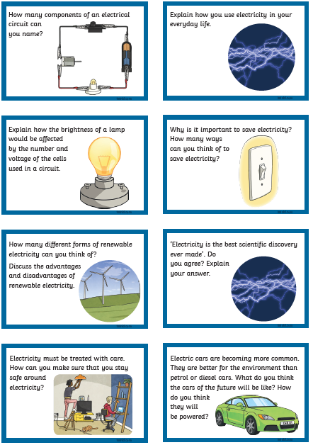
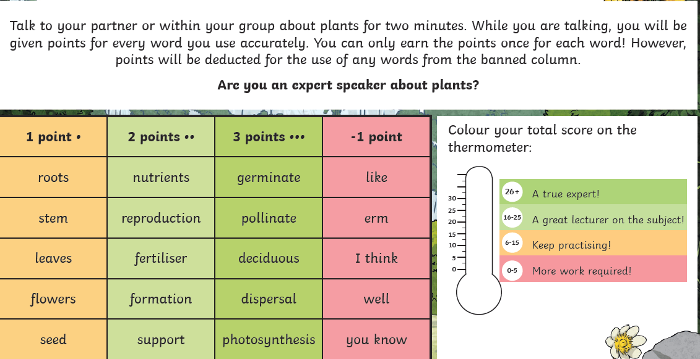
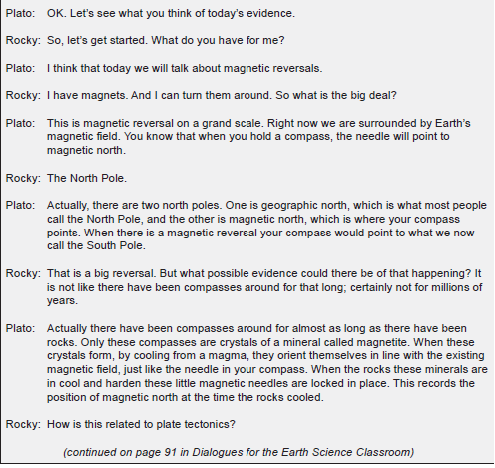
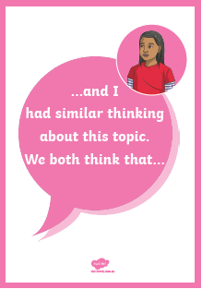
Further ideas for dialogue in your classroom
Notes:
Zoom in on each of these and explain: Conversation stems for modelling, Conversation cards for focus and guided research. Conversation game to promote use of TL. Roleplays to learn facts in an alternative way (good for different learning styles).
Conversation stems from twinkl
Science Dialogues: Dialogues for the Science Classroom by Craig Berg

Slide 26
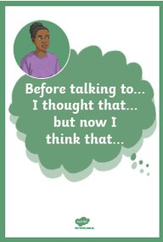
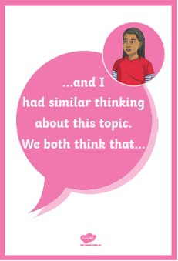
Primary Science

Slide 27
IGCSE Science

Slide 28
Overcoming obstacles
What obstacles do you feel you might encounter?
Whole school routines
Loss of control
Students go off-task
Lack of department support

Slide 29
What will you try?
Ground rules
Pair talk – repeating partners response
Token Talk
Dialogic story telling
Sentence stems
Dialogic role play

Slide 30
Thank you
Any questions?

